Slide 1
Real Time Threat Detection using Machine Learning and the CICIDS 2017 Dataset
NCS 495 – Capstone Presentation
By Sultan Taj

Slide 2
Agenda
Introduction
Dataset Overview
Methodology
Results and Discussion
Limitations
Conclusion and Future Work

Slide 3
Introduction
Problem
As innovations in technology continue to advance, zero-day attacks continue to rise and bypass our current security measures.
These growing attacks threaten critical sectors like healthcare, finance, and manufacturing.
Objective
Build a real-time intrusion detection system using machine learning.
Leverages the CIC-IDS 2017 dataset for model training and evaluation.
Purpose
Enhance network security against evolving cyber threats.
Develop a scalable and adaptive detection system for real-world applications.

Slide 4
Dataset Overview
Overview
The Canadian Institute of Cybersecurity from the University of New Brunswick created this benchmark dataset, used for intrusion detection research. Contains several types of traffic, making it ideal for training and evaluating machine learning models.
Traffic Types
Benign Traffic
Brute Force (FTP / SSH)
Denial of Service (DDoS / DoS)
Web Attacks (Brute Force, XSS, SQL Injection)
Botnet, Infiltration, PortScan
Challenge
Despite containing a large variety of network traffic, this dataset is heavily imbalanced with Benign traffic containing more than 2 million rows of data, while rare attack types have little as 11 samples.

Slide 5
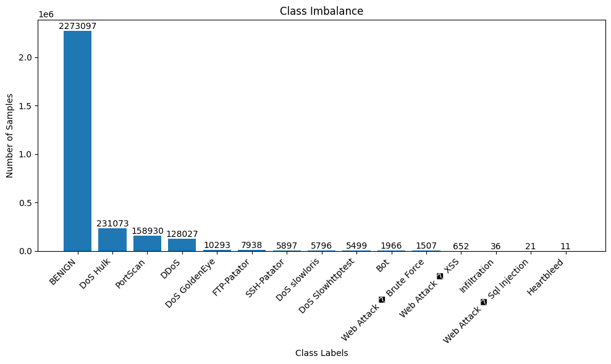
Raw Class Distribution
Fig. 1. Raw class distribution of original dataset

Slide 6
Data Preprocessing
Laurens D'Hooge Preprocessed Dataset
Metadata removed to prevent shortcut learning.
Reduced memory usage.
Removed duplicates.
Handled missing value.
Optimized feature data types for efficiency.
Data preprocessing steps
Utilized sampling to select 15% of the dataset for faster processing.
Manually increased samples for rare classes to ensure representation.
Made use of SMOTE to further balance the dataset.

Slide 7
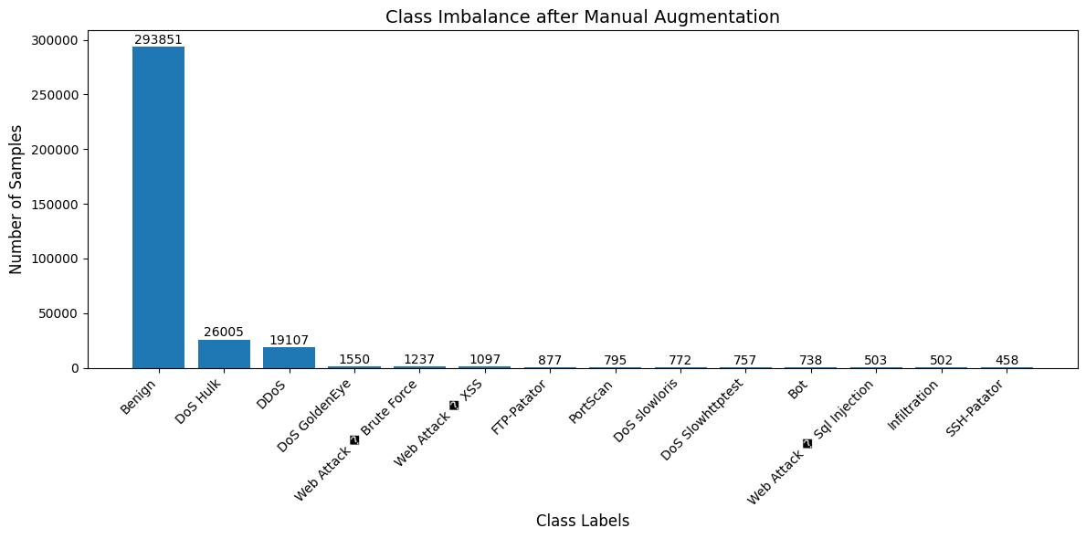
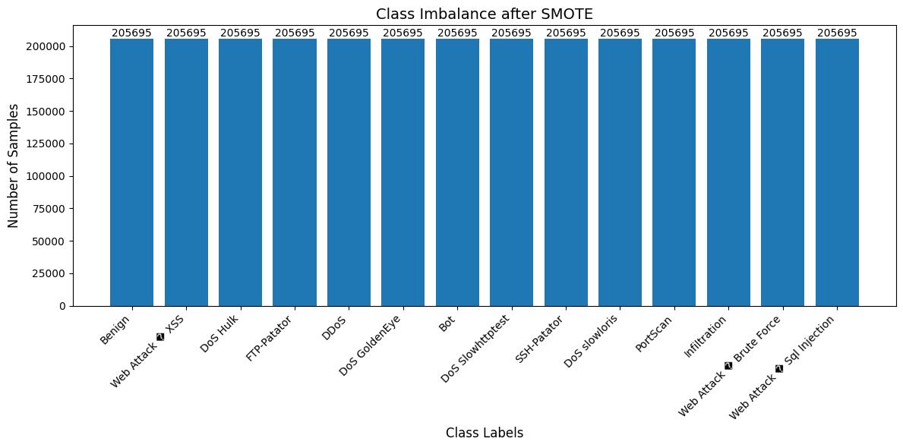
Preprocessed Class Distribution
Fig. 2. Class distribution after manual augmentation
Fig. 3. Class distribution after SMOTE​

Slide 8
Model Development
Random Forest (RF)
Ensemble learning method that uses decision trees for improved accuracy and stability.
Excels at handling class imbalance and provides interpretable feature importance.
Full Connected Neural Network (FCNN)
Explores relationships between all features using a densely connected architecture.
Explored to assess how well it can generalize across different attack types.
Convolutional Neural Network (CNN)
Ideal for detecting spatial and temporal patterns in network traffic data.
Ability to detect subtle anomalies in network traffic flows.
Voting Ensemble (VE)
Combines predictions from RF, FCNN, and CNN using a soft voting approach.
Chosen to utilize the strengths of each model, to improve performance and balance results.

Slide 9
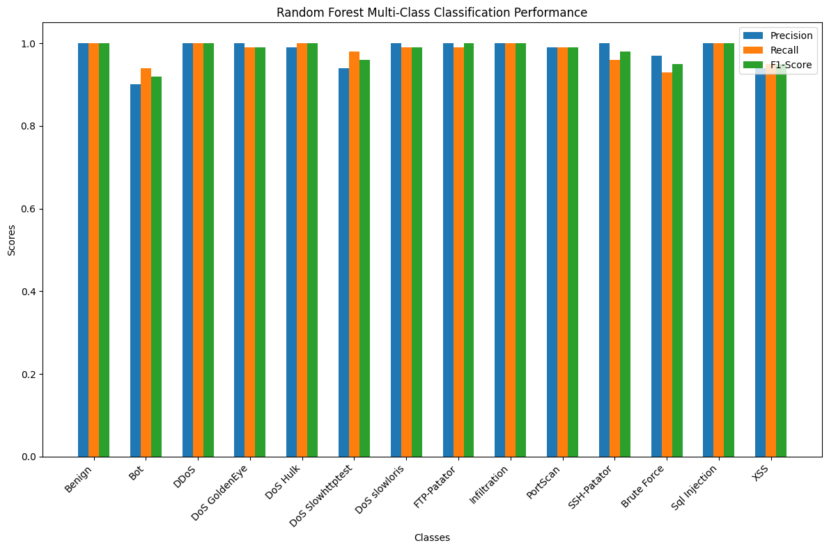
Random Forest Results
Fig. 4. Random Forest Model Performance

Slide 10
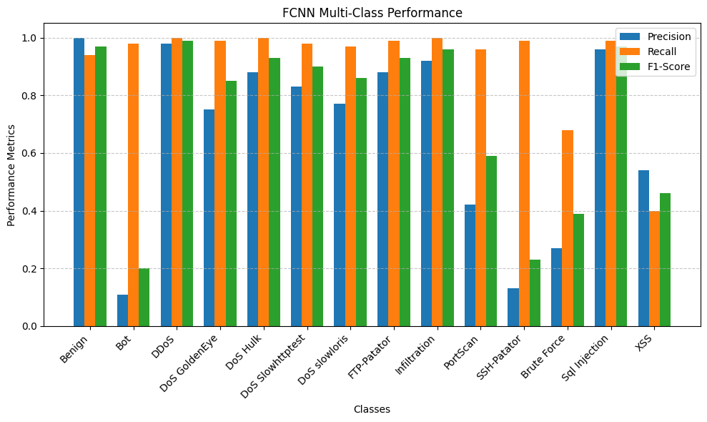
FCNN Results
Fig. 5. FCNN Model Performance​

Slide 11
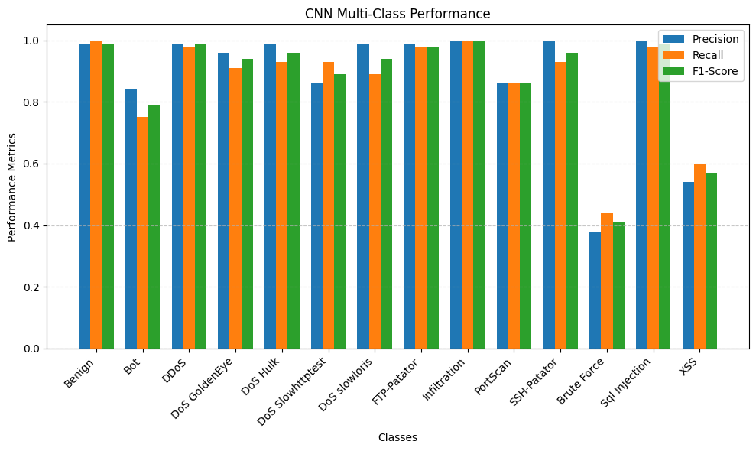
CNN Results
Fig. 6. CNN Model Performance​

Slide 12
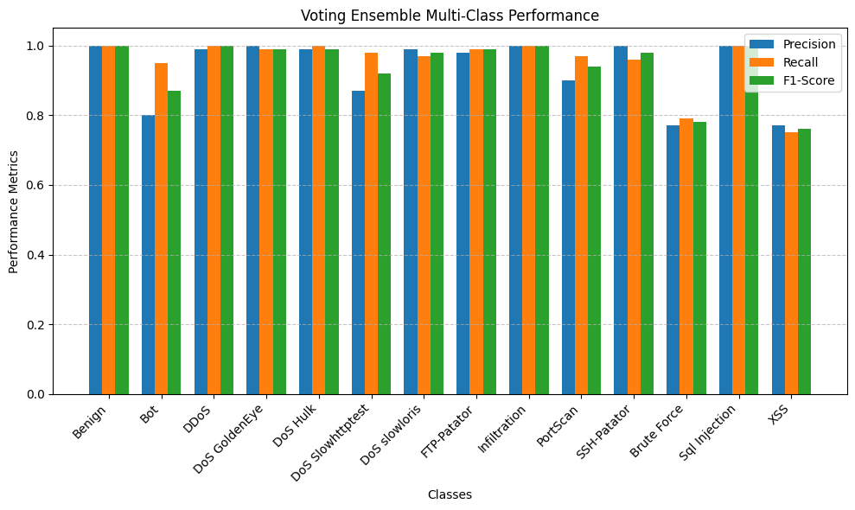
Voting Ensemble Results
Fig. 7. Voting Ensemble Model Performance​

Slide 13
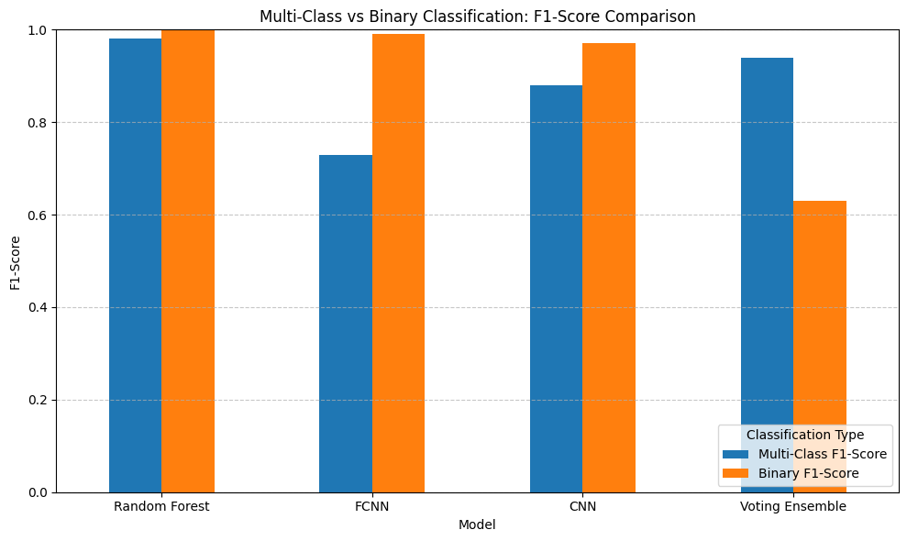
Binary vs Multi-Class
Zero-Day Approach
We can improve our results by simplifying our task. We can switch to binary classification by detecting binary and malicious traffic.
Results
By eliminating each specific attack type, the overall detection, accuracy, and F1-Score for malicious traffic is improved.
This switch to binary classification improve model reliability for real-time systems.
Fig. 8. Multi V.S. Binary F1-Score Comparison

Slide 14
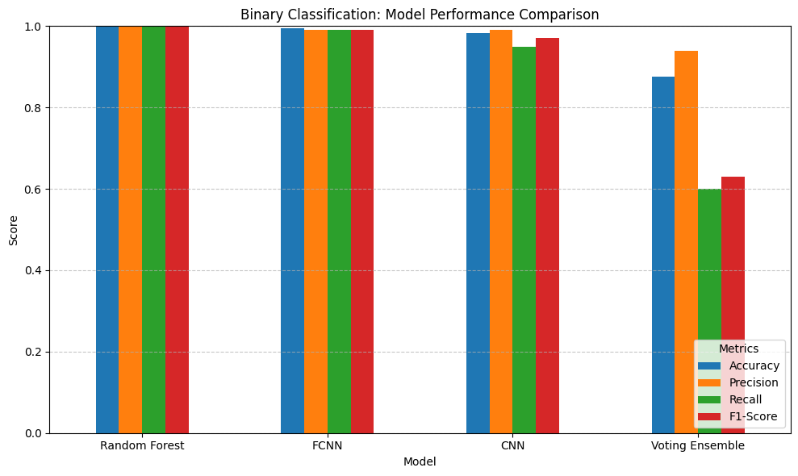
Binary Results
Fig. 9. Binary Model Performance Comparison (RF, FCNN, CNN, VE)

Slide 15
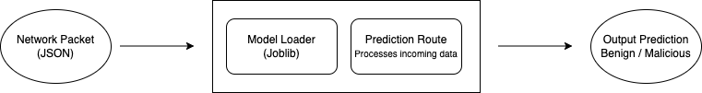
Deployment with Flask API
Overview
Flask API was used to deploy the Random Forest model for real-time inference.
Using Flask allowed for a lightweight and efficient webserver for creating prediction endpoints.
How it works
The Random Forest model is loaded using the joblib library.
Incoming data is processed through the /predict endpoint.
JSON-formatted packets are processed as "Benign" or "Malicious".
Fig. 10. Flask API Data Flow Diagram

Slide 16
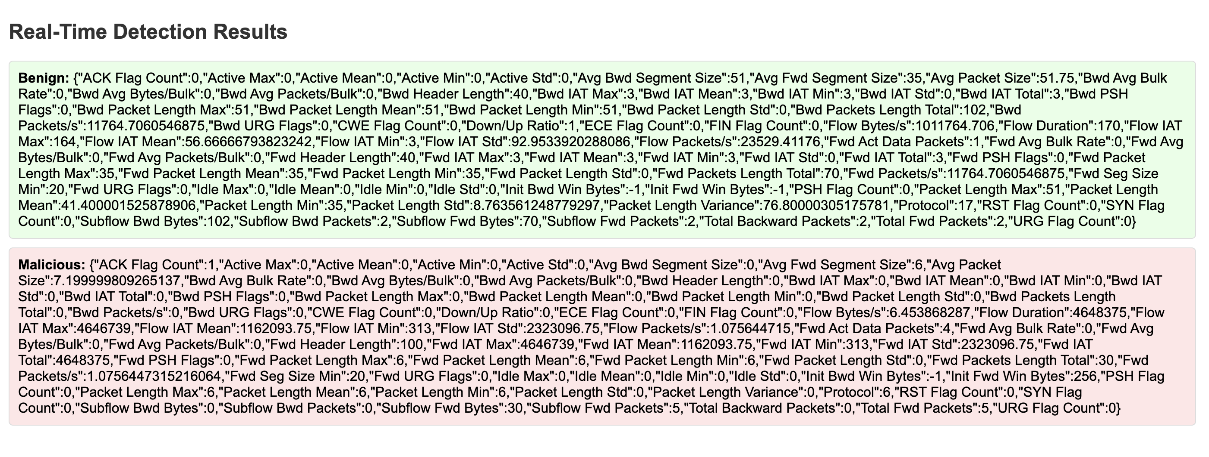
Flask API Results
Manual Testing
Packets from the CICIDS 2017 dataset were converted for manual testing.
Postman was used to send POST Requests containing these JSON-formatted packets to the /prediction endpoint of the Flask API.
As we can see from our results below, the mode correctly identified "Benign" and "Malicious" packets confirming model deployment readiness.
Fig. 11. Real-Time Flask API Results

Slide 17
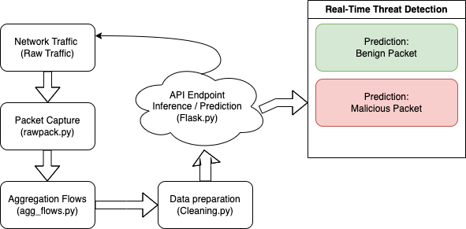
Integration Pipeline
Overview
This pipeline demonstrates the end-to-end process for real-time threat detection, bridging static model training with live network monitoring.
Steps:
Packet Capture: Collects raw network traffic in real-time using PyShark
Aggregation Flows: Convert raw packets into flow-level features such as packet size, counter, and inter-arrival times.
Data Preparation: Cleans aggregated data, removes duplicates, and formats it for model inference.
API Endpoint: Processes input data for real-time predictions
Fig. 12. Integration Pipeline Data Flow Diagram

Slide 18
Limitations
Traffic Generation
The virtual network setup used generated limited and repetitive traffic, reducing diversity needed for realistic testing.
Due to repetitive traffic, dataset would become empty after cleaning.
Packet Filtering
Applying BPF filters to exclude irrelevant packets resulted in no packets being captured, limiting real-world simulation capabilities.
Lack of Meaningful Data
Most captured packets consisted of broadcast or multicast traffic, providing insufficient data for flow aggregation.

Slide 19
Conclusion
Summary
Developed a real-time intrusion detection system using machine learning and the CICIDS 2017 dataset, focusing on both multi-class and binary classification approaches.
Experimented with different models to assess the practicality and effectiveness of various machine learning techniques.
Key Takeaways
Random Forest proved the most effective for binary classification, with high accuracy and reliability.
Successfully deployed a Flask API for real-time inference.
Significance
This work bridges the gap between machine learning research, and real-world cybersecurity applications, addressing the challenges of detecting malicious network traffic.

Slide 20
Future Work
Enhance Network Traffic Simulation
Explore advanced virtual environments with diverse and realistic traffic.
Refine Real-Time Packet Capture
Use PyShark in a private network environment to improve data collection.
Experiment with custom BPF filters to eliminate irrelevant packets.
Cloud-Based Deployment
Deploy Flask API on cloud platforms for scalability.
Integrate with SIEM tools (Splunk, Wazuh) for enterprise-level applications.
Advanced Model Development
Investigate ensemble methods and deep learning architectures for rare attack detection
Improve the system's ability to handle zero-day attacks

Slide 21
Sources
https://ieeexplore.ieee.org/document/9474286
https://www.kaggle.com/datasets/dhoogla/cicids2017
https://pmc.ncbi.nlm.nih.gov/articles/PMC9740321/
https://www.kaggle.com/code/angelarentsi/cicids-2017-dataset-with-cnn
https://www.kaggle.com/code/angelarentsi/cicids-2017-models-summary
https://www.kaggle.com/code/nolovelost/cic-ids-2017-cnns-v-1-0
https://www.sciencepubco.com/index.php/ijet/article/view/22797/11274
https://ieeexplore.ieee.org/document/10077796

Slide 22
Questions
Thank you for your time!
Feel free to ask any questions!

